Slide 1

Case study 2
DDS Analytics
Patricia Herrera

Slide 2
Objectives:
Determine why employees leave DDSAnalytics
Identify the top three factors that contribute to turnover
Identify job role specific trends that may exist in the data set
Provide any other interesting trends and observations from your analysis
Build a model to predict attrition
Naïve Bayes model
60 % specificity and 60 % sensitivity requirement
Build a model to predict monthly income
Linear regression model
RMSE < 3000 requirement

Slide 3

Exploratory Data analysis
NA Values
Predictor Exploration
Over 18
Employee Count
Standard Hours
Performance Rating

Slide 4
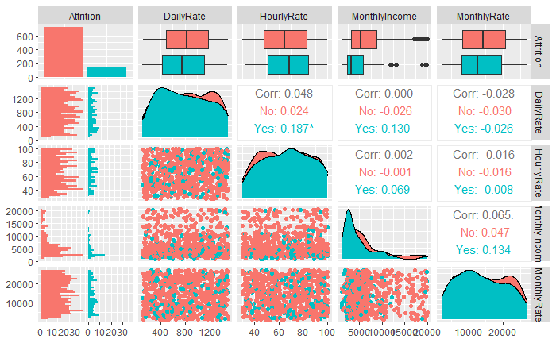

Slide 5
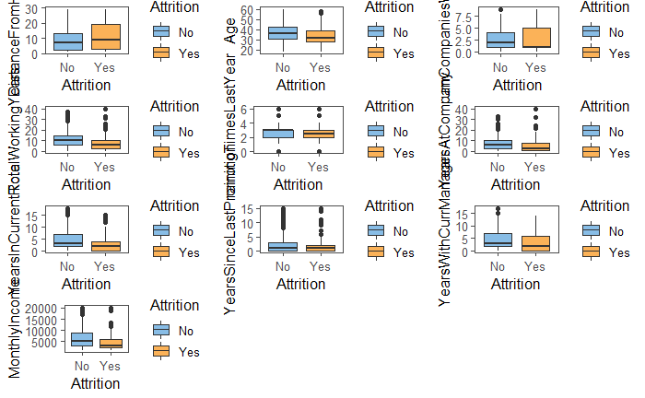

Slide 6
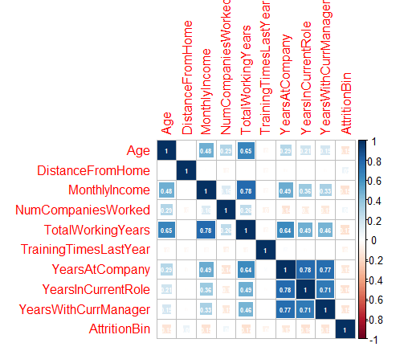

Slide 7
Omitted variables:
Over18
StandardHours
EmployeeCount
PerformanceRating
DailyRate
HourlyRate
Monthly Rate
YearsSinceLastPromotion
PercentSalaryHike
WorkLifeBalance
YearsInCurrentRole
YearsSinceLastPromotion
YearsWithCurrManager

Slide 8
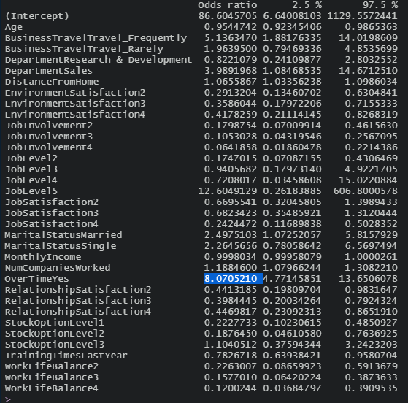
Identify the top three factors that contribute to turnover
JobLevel5
OverTimeYes
BusinessTravelTravel__Frequently

Slide 9
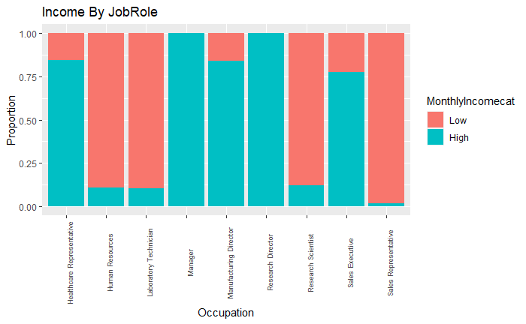
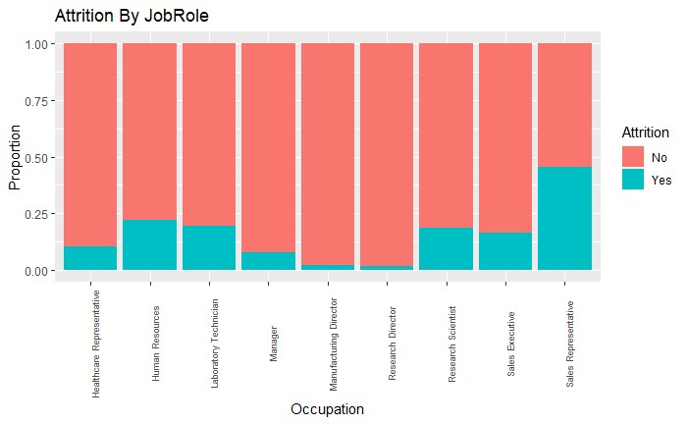
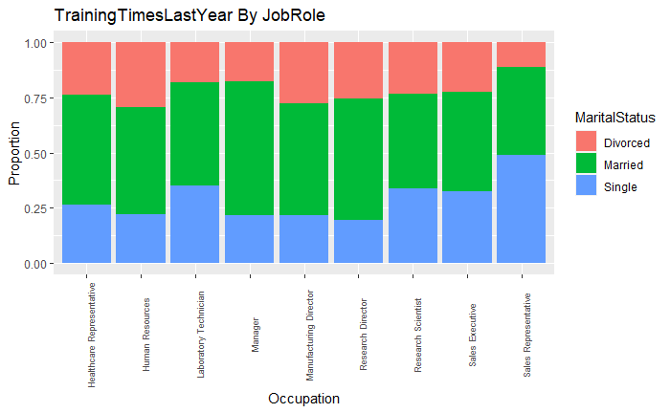
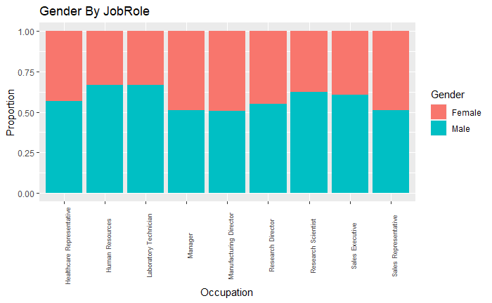
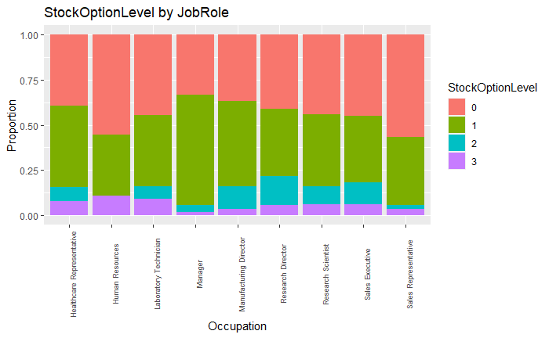
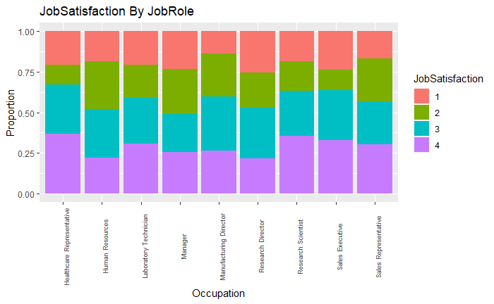
Identify job role specific trends that may exist in the data set.
Monthly Income
Attrition
Gender
Training Times Last Year
Job Satisfaction
Stock Option Level

Slide 10
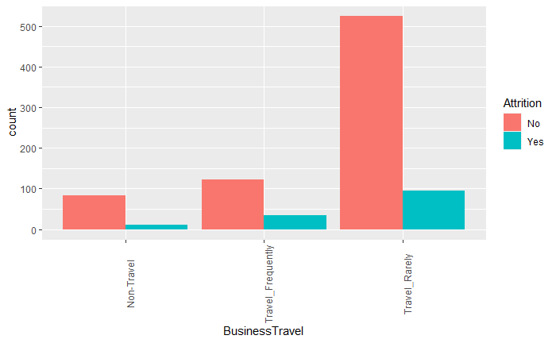
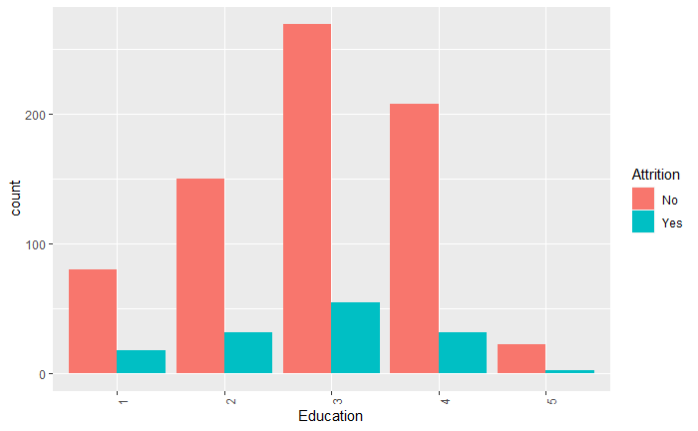
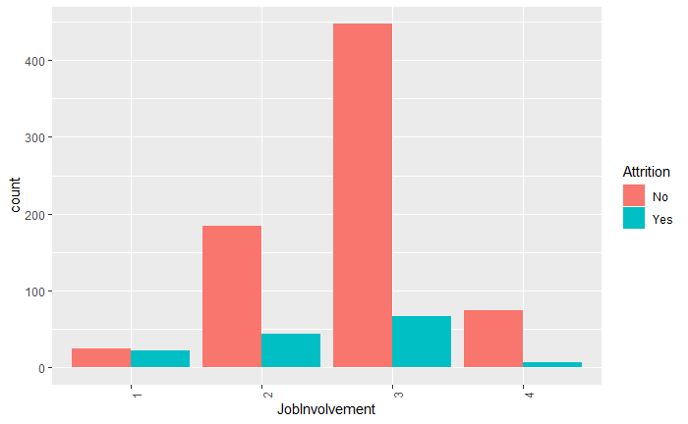
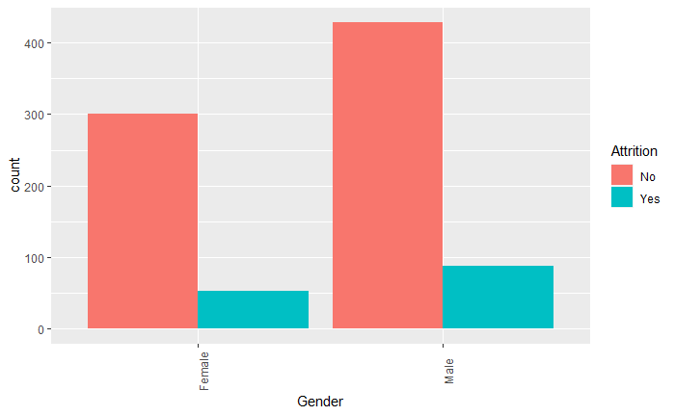
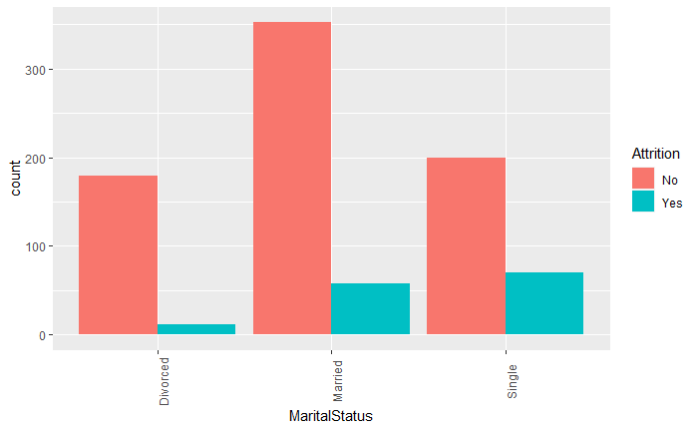
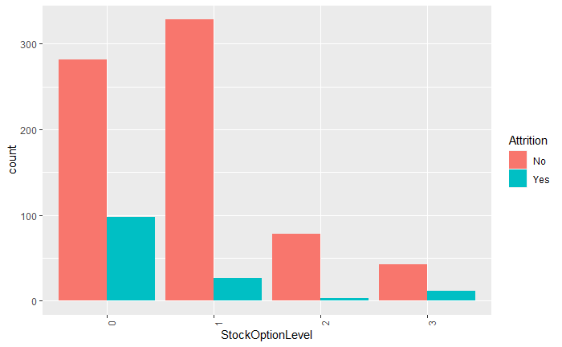
Provide any other interesting trends and observations from your analysis.
Business Travel
Education
Gender
Job Involvement
Marital Status
Stock Option

Slide 11
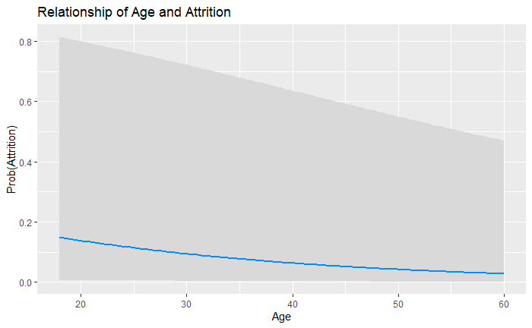
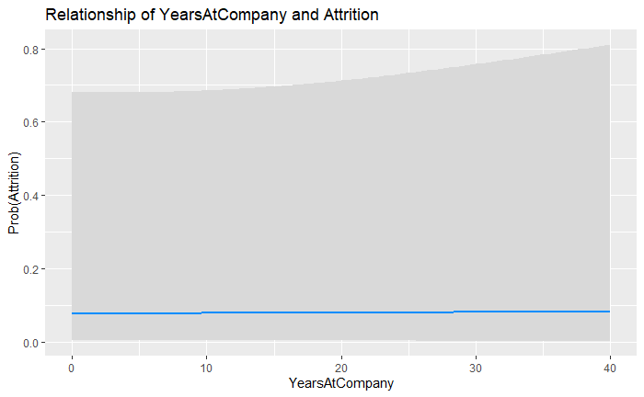
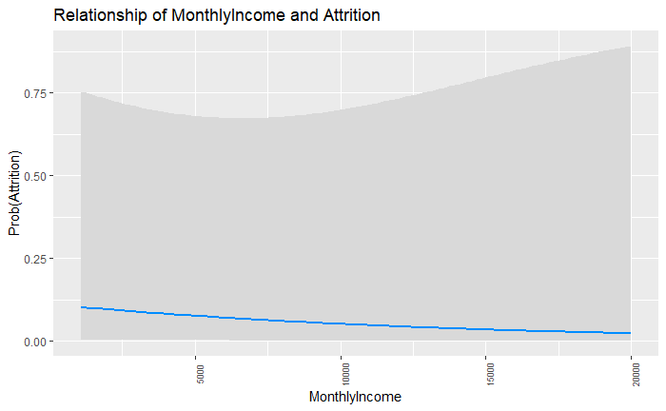
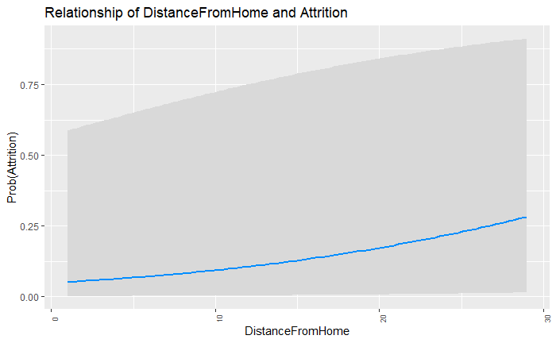
Provide any other interesting trends and observations from your analysis.
Age
Years at Company
Monthly Income
Distance From Home

Slide 12
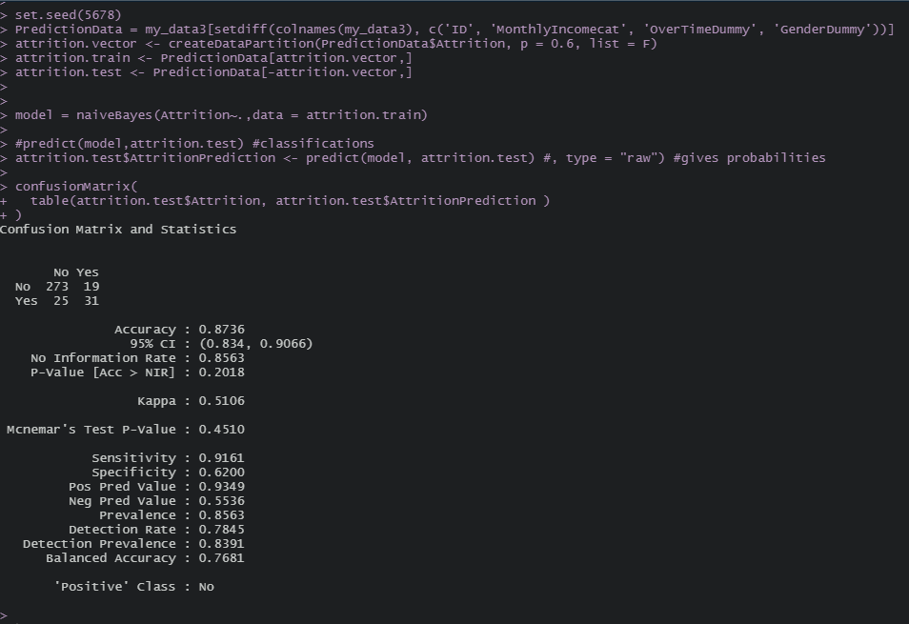
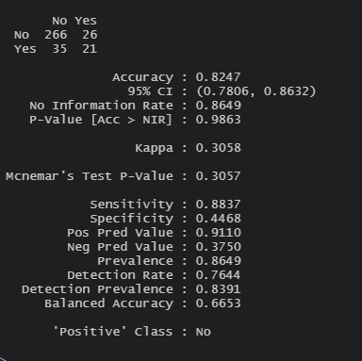
Model Comparison
Naïve Bayes Model
Boosted Logistic Regression
The Naïve Bayes model overall has a better accuracy, sensitivity and specificity than the logistic regression model.

Slide 13
Model Comparison
Boosted Logistic Regression

Slide 14
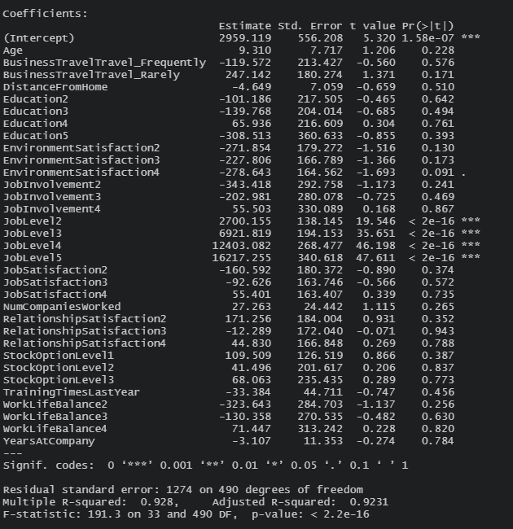
Monthly income model
Linear Regression Model

Slide 15
Conclusion & Recommendations
Trends about monthly income
Trends about job roles
Determined the top three factors that contribute to employee turnover
Over Time
Business Travel
Job Level
Built a Naïve Bayes model for attrition
Sensitivity of 91%
Specificity of 62%
Accuracy of 87%
Built a linear regression model to predict monthly income
RMSE 1297

Slide 16
Links
YouTube
https://youtu.be/3rklu2ftaX4
GitHub
https://github.com/therrera3215/Doing-Data-Science---Case-Study-2

